Slide 1

University Institute of Engineering
DEPARTMENT OF COMPUTER SCIENCE & ENGINEERING
Bachelor of Engineering (Computer Science & Engineering)
Subject Name : SEARCH ENGINE OPTIMIZATION
Subject Code: 20CST-463
Topic: Lecture-1.1.3
Lecture- Keyword Research
By : Sourabh Budhiraja
DISCOVER . LEARN . EMPOWER

Slide 2

Syllabus
UNIT-1: Introduction to Search Engine Optimization
CHAPTER-1: Introduction to Search Engine Optimization:
Understanding of search engines, Basics of SEO, Keyword Research, On-Page Optimization, Technical SEO.
CHAPTER-2: Content Creation and SEO tools:
Content Creation for SEO, SEO Analytics, SEO Tools, Local SEO, SEO Ethics and Future Trends.

Slide 3
CONTENTS
What is Keyword in SEO?
Key points about keywords
What is Keyword Research ?
Step by Step guide to Keyword Research

Slide 4

What is Keyword in SEO?
In SEO (Search Engine Optimization), a keyword is a specific word or phrase that users enter into a search engine when looking for information, products, or services. Keywords are fundamental to the process of optimizing a website for search engines because search engines use these terms to determine the relevance of a web page to a user's query.
Fig. 1.1.3(a)

Slide 5
Key points about keywords(Cont.)
1. Relevance: Keywords should be relevant to the content of a web page. When users search for a particular keyword, search engines aim to provide results that are most relevant to the user's query.
2. User Intent: Consider the intent behind a user's search. Keywords can be classified into different types based on user intent, such as informational (seeking information), navigational (looking for a specific website), and transactional (intent to make a purchase).
3. Long-Tail Keywords: Long-tail keywords are longer and more specific phrases that often have less search volume but can be highly targeted. They are valuable for capturing users with very specific queries.

Slide 6
Key points about keywords(Cont.)
4. Competitiveness: Some keywords are highly competitive, meaning many websites are trying to rank for them. It can be challenging for a new or small website to rank well for highly competitive keywords, so a strategic approach is important.
5. Keyword Research: Keyword research is the process of identifying and analyzing keywords that are relevant to a business or content. This involves understanding search volume, competition, and selecting keywords that align with the goals of the website.
6. On-Page Optimization: Once keywords are identified, they are strategically integrated into various elements of a web page, including the title tag, meta description, headers, and content. This on-page optimization helps search engines understand the context of the page.

Slide 7
Key points about keywords(Cont.)
7. Content Creation: Creating high-quality, relevant content around targeted keywords is essential. Content that aligns with user intent and provides value is more likely to rank well in search results.
8. Tracking and Analysis: Monitoring the performance of keywords is crucial. Webmasters use tools like Google Analytics or other SEO software to track how well their website ranks for specific keywords, the amount of traffic generated, and user behavior.
9. Dynamic Nature: The SEO landscape evolves, and user behavior changes. Regularly updating keyword strategies based on shifts in industry trends, user preferences, and search engine algorithms is important for ongoing success.

Slide 8
What is Keyword Research ?
Keyword research in SEO is the process of identifying and analyzing the specific words and phrases that users enter into search engines when looking for information, products, or services. It is a fundamental aspect of search engine optimization as it helps website owners understand what their target audience is searching for and allows them to optimize their content accordingly. Effective keyword research is crucial for improving a website's visibility in search engine results and attracting the right audience.

Slide 9
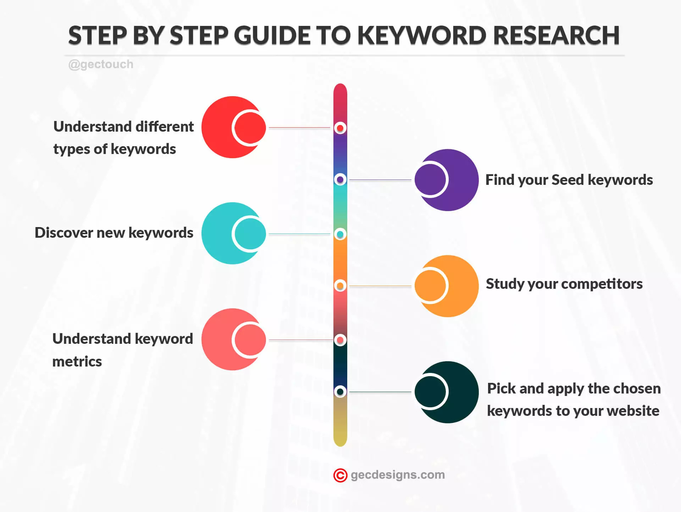
Step by Step guide to Keyword Research
Fig. 1.1.3(b)

Slide 10
References
Books and Journals
Eric Enge, Stephan Spencer, Rand Fishkin, Jessie C Stricchiola, “The Art of SEO : Mastering Search Engine Optimization”, O'Reilly Media, October,2009.
https://www.hubspot.com/hs-fs/hub/53/file-13221845-pdf/docs/ebooks/introduction-to-seo-ebook.pdf
Fhttps://www.startupgeeks.it/wp-content/uploads/2018/12/ebook-seo-sej-complete-guide-2018.pdf
Video Link-
https://youtu.be/xsVTqzratPs
https://youtu.be/t12u9vD-ip0?list=PLc20sA5NNOvqY8K-gtLCljTDTP6-SMruP
Web Link-
https://www.geeksforgeeks.org/search-engine-optimization-seo-basics/
https://www.tutorialspoint.com/seo/index.htm

